Slide 1
GIT – The versatile version control system

Slide 2
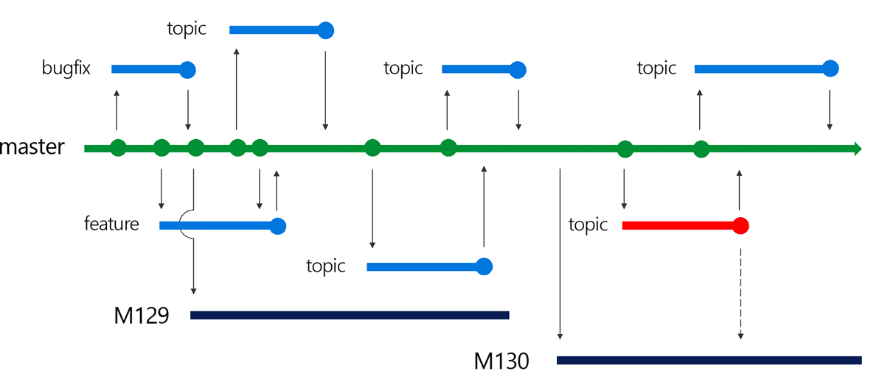
What is Version Control System (VCS)
Software that helps software developers to work together and maintain a complete history of their work.

Slide 3
VCS - Function
Allows developers to work simultaneously.
Does not allow overwriting each other’s changes.
Maintains a history of every version.

Slide 4
VCS - Types
Centralized version control system (CVCS)
Perforce
CVS
SVN
ClearCase
Distributed/Decentralized version control system (DVCS)
GIT
Mercurial

Slide 5
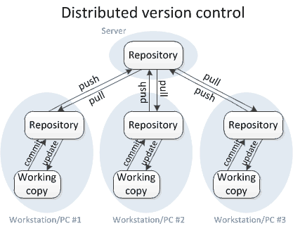
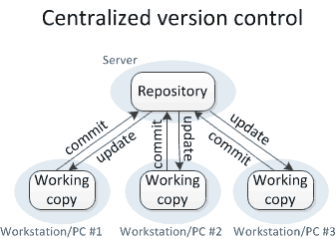
VCS - Comparison
Distributed (GIT) | Centralized (Perforce)
Every developer has full history of code locally | Requires a connection to the server even to see the history of changes
Initial clone of the code is slower but subsequent operations are faster | Single central server becomes bottleneck as teams and project get bigger. Many commands require write access to the server and it can be sluggish when thousands are online

Slide 6
GIT - Advantages
Distributed
Free and open source
Fast and small
Implicit backup
Security
No need of powerful hardware (cloud-based)
Easier branching
No need to be online always
No single point of failure

Slide 7
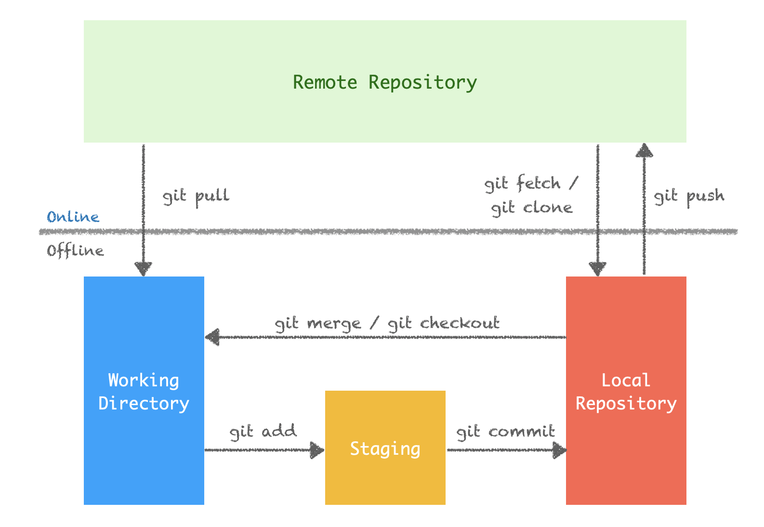
GIT - Setup

Slide 8
GIT - Common commands
# git clone <path> | # git pull <origin> <branch-name>
# git init | # git branch <options>
# git fetch <repo-name> <options> | # git push <options>
# git checkout <options> | # git status <options>
# git add <options> | # git log <options>
# git commit <options> | # git merge <branch-name>
# git diff <options>

Slide 9
GIT – Hands on

Slide 10
Thanks ☺

